Slide 1
Design & Development of Guest Management System
Harsh Pateria 2017A7PS0129H
Asish Nelapati 2017B4A41035H

Slide 2
Introduction
Department: - Information Technology (IT)
Department Head: - Mr. G. V. Radhakishan
HR Instructor: - Mr. Rahul Singh
PS Instructors: - Dr. Piyush Chandra Verma
Mr. B Suryanarayana

Slide 3
About the Company
Surrounded by the limestone hills, Dalla cement factory started at Dala in 1971. This Cement plant was the Biggest plant in Asia. The cement factories became the foundation on which other industries were built. It was then sold to Jaypee group in the year 2008 and then it has been taken by UltraTech for 16500 crores(paid for 4 plants collectively).
Dalla cement factory was acquired by UltraTech Cement from Jaypee Group in 2016. It has made a name for itself in the list of top suppliers of cement in India. The company is located in Sonbhadra, Uttar Pradesh and is one of the leading sellers of cement.
This factory mainly produces Portland Pozzolana Cement(PPC) and clinker. PPC is a variation of Ordinary Portland Cement(OPC) in which fly ash is mixed to lower its initial setting strength but it hardens over a period of time with proper curing.

Slide 4
Abstract
Till now all the guest details in the guest house are recorded manually in registers. It is not a good practice to record all the information in registers. Also, to find information about a particular guest, it is a hard task and people had to manually check all the entered records to get to the information. Hence there was a need of an automatic system that could do all the possible tasks as demanded by the admin. So, we developed a standalone Software System that stores the details of every guest, and returns the required information on single click commands. We used JAVA and MySQL to do it. The interface is very user friendly and is secure. Using our system, the admin can do all the tasks that we mentioned above. Moreover, there is an option to generate receipts for a person. It uses the concept of OOPs, DBMS, JDBC and many more concepts. Every Guest is identified by a unique identification number. It’s easy for the admin to operate on the software.

Slide 5
Concepts Used
Procedural Programming paradigm.
Object oriented programming (OOPS).
JAVA
DataBase Management System (DBMS).
MySQL

Slide 6
Procedural Programming Paradigm
In this approach, the program is divided into functions that perform specific tasks
This approach is mainly used for medium-sized applications.
Data is global, and all the functions can access global data.
The basic drawback of the procedural programming approach is that data is not secured because data is global and can be accessed by any function.
These programming constructs were developed in the late 1970s and 1980s. There were still some issues with these languages, though they fulfilled the criteria of well-structured programs, software etc.
Procedure calls are modular and are bound by scope.
There are several kinds of major programming paradigms: Imperative, Logical, Procedurtal and Object Oriented.
Advantages of Procedural Programming: Its relative simplicity, and ease of implementation of compilers and interpreters. The ability to re-use the same code at different places in the program without copying it. An easier way to keep track of program flow. The ability to be strongly modular or structured

Slide 7
OOP(Object-oriented Programming)
Object-oriented programming (OOP) is a programming paradigm based on the concept of "objects", which can contain data, in the form of fields (often known as attributes), and code, in the form of procedures (often known as methods). A feature of objects is an object's procedures that can access and often modify the data fields of the object with which they are associated (objects have a notion of "this" or "self").
Classes – the definitions for the data format and available procedures for a given type or class of object; may also contain data and procedures (known as class methods) themselves, i.e. classes contain the data members and member functions.
Objects – instances of classes.

Slide 8
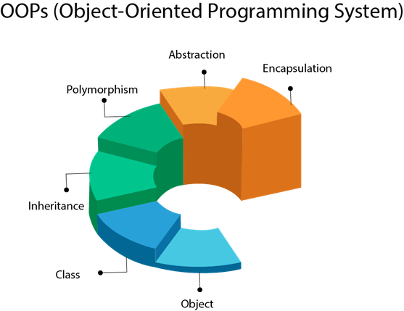
JAVA
Java is a general purpose programming language that is class-based, object-oriented,and designed to have as few implementation dependencies as possible.invented by james gosling introduced in 1995 it is no doubt one of the most used programming language.
The buzzwords of JAVA.
WORA (Write Once, Run Anywhere. )
Portable
Object-oriented
Robust
Multithreaded
Architecture-neutral
Interpreted
High performance
Distributed
Dynamic

Slide 9
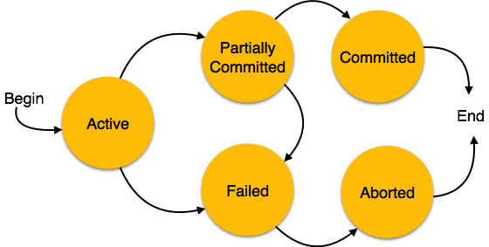
DBMS
Database Management System or DBMS in short refers to the technology of storing and retrieving users’ data with utmost efficiency along with appropriate security measures. This tutorial explains the basics of DBMS such as its architecture, data models, data schemas, data independence, E-R model, relation model, relational database design, and storage and file structure and much more.
Databases follow the ACID Properties : :

Slide 10
MySQL
MySQL is an open-source relational database management system. Its name is a combination of "My", the name of co-founder Michael Widenius's daughter, and "SQL", the abbreviation for Structured Query Language.
Written in C and C++.
Can be easily connected to Java and other languages.
There is a library in Java that helps in the connection of Java with MySQL.
JDBC Connectivity

Slide 11
Problems with Log Book
Entering and storing data manually is a tough task to do due to many reasons like :-
Human Errors like spelling mistakes, misinterpretation of data, not saving work and mistyping in the wrong fields are all common errors seen in the data entry field.
Speed , Retrieval of Data is not possible in case of log books. It is a tiresome process to get the records of a particular guest who might even have arrived a long time back.
There is always a chance that due to confusion and misinterpretation, the information gets entered twice for a person.
If the guest wants to get his room changed, it has to be reflected in the logbook and it is a hard task in the sense that the log book is just a register.
Generation of Reports is not possible in case of logbooks. That is, we cannot generate records of all the people who came in a certain period of time.
There is no option for generation of a receipt.
There are lot more of errors humans do. There by we can say that it is the ideal way to let computer do the job . so, to make it very easy any usable to the employees we made an App to overcome all these difficulties and get the job done in a click.

Slide 12
Is The DATA Secure ?
Yes, the Data is Secure. JAVA, itself is a secure language and it already has inbuilt security features so that no breach of information is possible.And MySQL is a Relational Database Management System which is also very secure. This being a corporate company we know how important privacy is for you Also , The passwords for the Admin and the User are hashed twice i.e its twice encrypted and checked before the system lets you log in, and it’s nearly impossible to break into the password with this level of security. And we also provided a “commit all records” option in the app where you can save you stored data in another table from time to time . so that if anything unexpected happens you still can back it up with this stored data. There are even two interfaces designed for Admin and User to make sure that any worker can’t access all the info stored without Admin knowing. The whole data will be stored in MYSQL DataBase which is highly reliable in the form of tables and this being a stand alone system no one gets to see all those data except the admin. So, we can strongly say that all the DATA is impenetrable and its highly secure and reliable

Slide 13
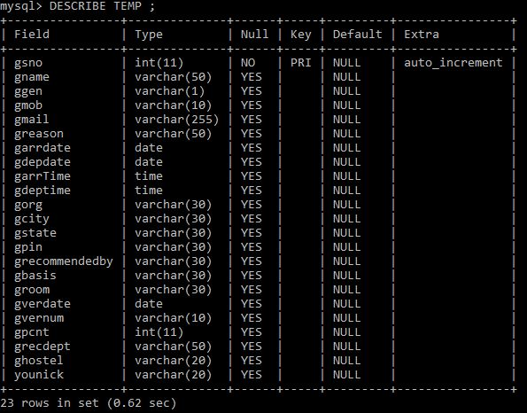
Tables in MYSQL

Slide 14
What if the APP Stops Working ?
The app won’t stop working. The reason being that it is a small application and based on JAVA, So it is platform independent and uses very less space and memory. The only memory it uses is in the storage of data in the database.
We have tested the app so that there are no errors in it and a rigorous testing has been done on the memory consumption and space utilisation of the app and it’s working fine in all conditions.

Slide 15
System Requirements to run the APP
The system must have the following needs to run the app on it:-
MYSQL Command line prompt. / terminal to run MySQL
JAVA should be installed on the system
Our app is Platform Independent. It can run in any Windows environment and even in Ubuntu and Linux too. The only thing is that MySQL commands be identified by the system and it should have JRE (Java Runtime)
With these two basic requirements your app runs without a flaw . just download the .jar file and run it on your system .

Slide 16
Benefits of using this APP
It’s secure and reliable to store data about guests using this app.
You don’t have search the whole log book to find a guest, with a single click you can get it retrieved from database.
It's impossible to change info regarding guests without admin’s vision.
User has only access to certain parts of the app with admin being the only one to see the whole data and records.
No Manual Errors, if a book gets lost or got burnt there is no way of getting info back. now with this app the whole data is safe and secure in PC.

Slide 17
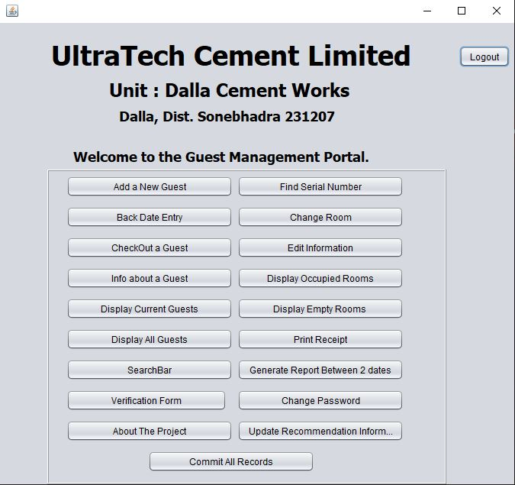
A Look at the Front End

Slide 18
Back End
The Back End of the software is in JAVA and the database is in MySQL.
The

Slide 19
The Presentation of the Software

Slide 20


Slide 21


